Slide 1

DUKE AIPI 590 · ALTERNATIVE DATA · FINAL
Climate Impacts on
Futures Pricing
What free weather data can measure, what the market already knows,
and who can still use the difference
Haydn Stucker · November 2026
Notes:
0:15 · leave by 0:15
• Haydn Stucker · AIPI 590 final
• In one sentence: free weather data measures a real corn supply shock, and the futures market has already priced it

Slide 2


One project, two tests, one answer
The measurement worked and the trading signal failed — these are not in tension
MEASURE
PREDICT
Can public climate data identify real crop supply shocks?
Can those signals predict tradeable commodity returns?
Yes — in the seasons that matter
No — and now we know why
WHAT TO WATCH FOR
Every result that follows carries a second number: the same test with 2012 removed and every fold refitted. One drought season recurs in all of them, and how much each result depends on it is the honest measure of what this project established.
Both tests use the same point-in-time archive and the same publication-aware feature construction.
Notes:
0:40 · leave by 0:55
• Two tests from the proposal: MEASURE the shock, PREDICT returns
• Measurement worked, prediction did not — not a contradiction, it is what efficiency looks like
• Flag the device: every result carries a "2012 removed" number. Tell them to watch it

Slide 3
What worked: measuring corn supply risk
County weather and drought beat a training-only trend forecast on held-out harvests
+0.748
+0.476
0.31
R² vs trend, 16 forward-validated harvests
the same test, 2012 removed and refitted
t/ha mean error, against the trend’s 0.58
Positive in both samples. Every fold trains only on earlier harvests and refits the yield trend inside itself, so no held-out year helped define what counts as normal for itself.
But this is post-harvest attribution, not an in-season forecast: county weather reached only 3 of 26 growing seasons in time to be used.
Metric: R² against each fold’s own trend forecast. Source: corn_yield_forward_validation_results.csv.
Notes:
1:05 · leave by 2:00
• County heat and drought beat a training-only trend forecast on held-out harvests
• Forward validation — train on earlier years only, refit the trend inside every fold
• 75% of trend error removed; 48% with 2012 refitted out
• Both positive. Narrower than it sounds: county data reached only 3 of 26 seasons in time
IF ASKED — "why not benchmark against USDA's own forecast?"
Fair, and the stronger bar. Condition ratings are in the archive from 2012.
A trend forecast is the benchmark because anyone can build it with no weather
data at all. USDA's forecast is honest future work.

Slide 4
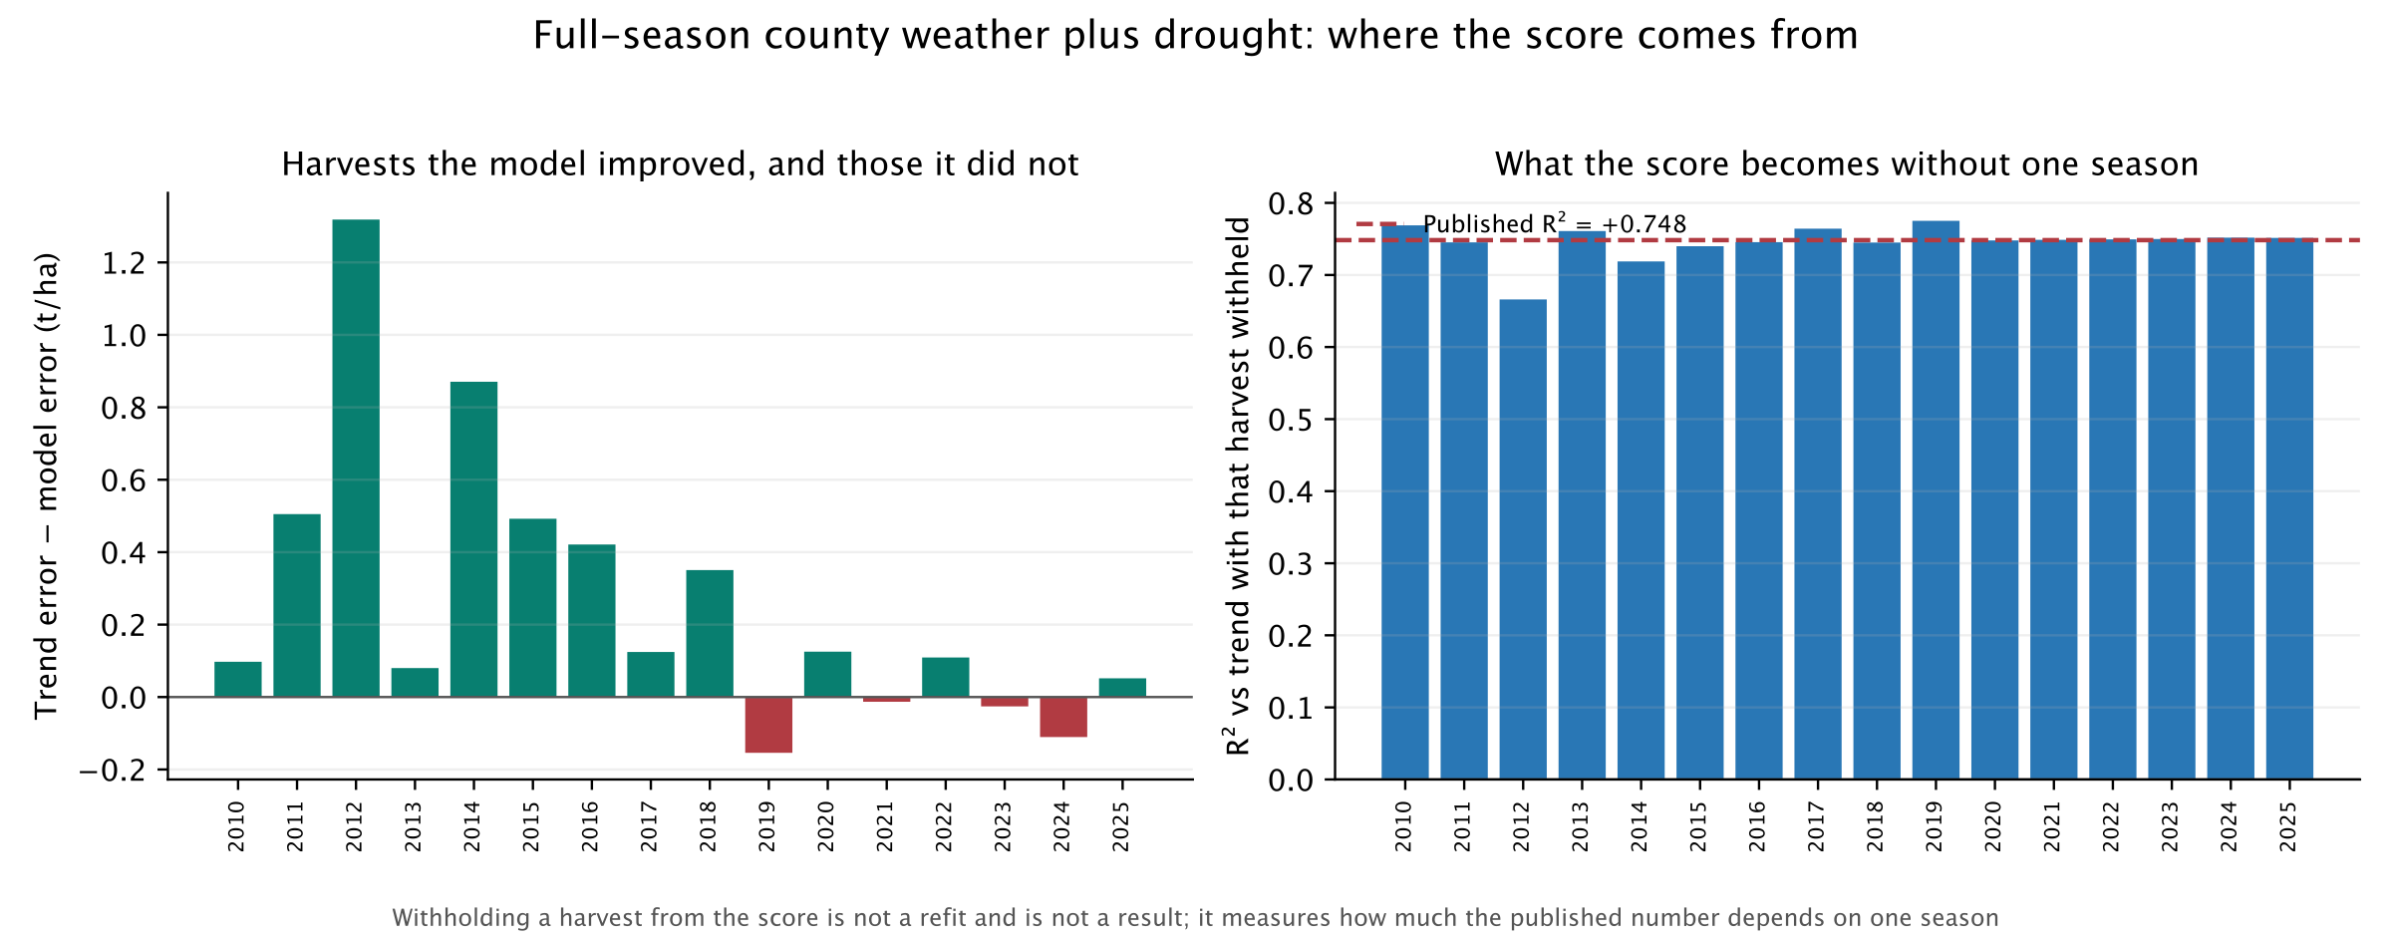
Where the result actually lives
Not a single-season artifact — but concentrated in the seasons that went wrong
+0.666 to +0.775
+0.815
−0.452
range when any single harvest is withheld from the score
in the third of seasons furthest from trend
in the calmest third, with 2012 refitted out
Withholding a harvest from a score is not the exclude-2012 sample, which also drops it from training and refits every fold.
Notes:
1:05 · leave by 3:05
• Withhold any single harvest: score stays +0.666 to +0.775, no sign flip
• So not one season's artifact — but concentrated
• +0.815 in the most extreme third; −0.452 in the calmest third without 2012
• Land it: this is a damage function. It works when the crop is failing
IF ASKED — "isn't 2012 just an outlier to drop?"
Two different tests, both reported. Out of the SCORE leaves +0.666.
Out of TRAINING, refitting every fold, leaves +0.476. Neither removes
the result; it is the season doing the most work.

Slide 5
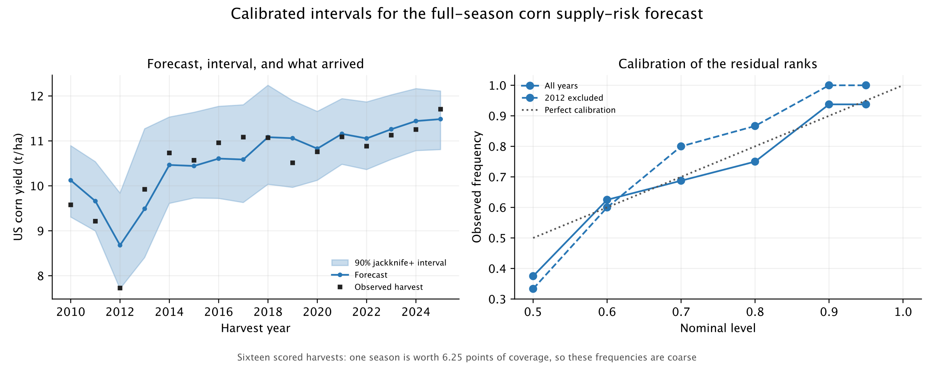
How precise is the estimate?
Calibrated intervals, with coverage measured rather than assumed
16/16
±8.7%
0.018 t/ha
covered at a nominal 90%; the guarantee is only 80%
of trend yield — the honest resolution of the estimate
the margin by which 2012 stays inside its interval
Jackknife+ on chronological folds; every narrower construction tested leaves 2012 outside.
Notes:
1:00 · leave by 4:05
• A point forecast is not a risk estimate — a buyer needs the spread
• Jackknife+, calibrated on earlier harvests only; coverage measured, not assumed
• 16/16 at nominal 90% — say that the guarantee is only 80%
• 2012 clears its bound by 0.018 t/ha. Price of coverage: ±8.7% of trend
IF ASKED — "16 observations cannot calibrate anything"
Agreed — which is why the method is distribution-free rather than Gaussian,
and why coverage is quoted with its resolution: one season is 6.25 points.

Slide 6

What failed, and how we know
Every candidate was frozen before its final test — and none was retuned afterwards
GEFS forecast revisions
−7.3% net
Sharpe −0.98
14 sealed-holdout trades
USDA Crop Progress
−52.7% net
Sharpe −0.81
positive in 3 of 9 years
THE DISCIPLINE IS THE RESULT
Candidate identity, costs and gate checks were committed before each reveal.
Seven predeclared checks failed on the USDA model, so its 2026 holdout was never opened.
No specification was retuned after a gate failure — the avenue was closed instead.
Sources: gefs_corn_holdout_results.csv, nass_corn_progress_validation_results.csv.
Notes:
0:50 · leave by 4:55
• The other half. Every candidate frozen before its final test
• GEFS sealed holdout −7.3%, Sharpe −0.98; USDA −52.7%
• Seven predeclared checks failed, so the 2026 holdout was never opened
• Nothing retuned after a gate failed. This is the result, not a setback

Slide 7
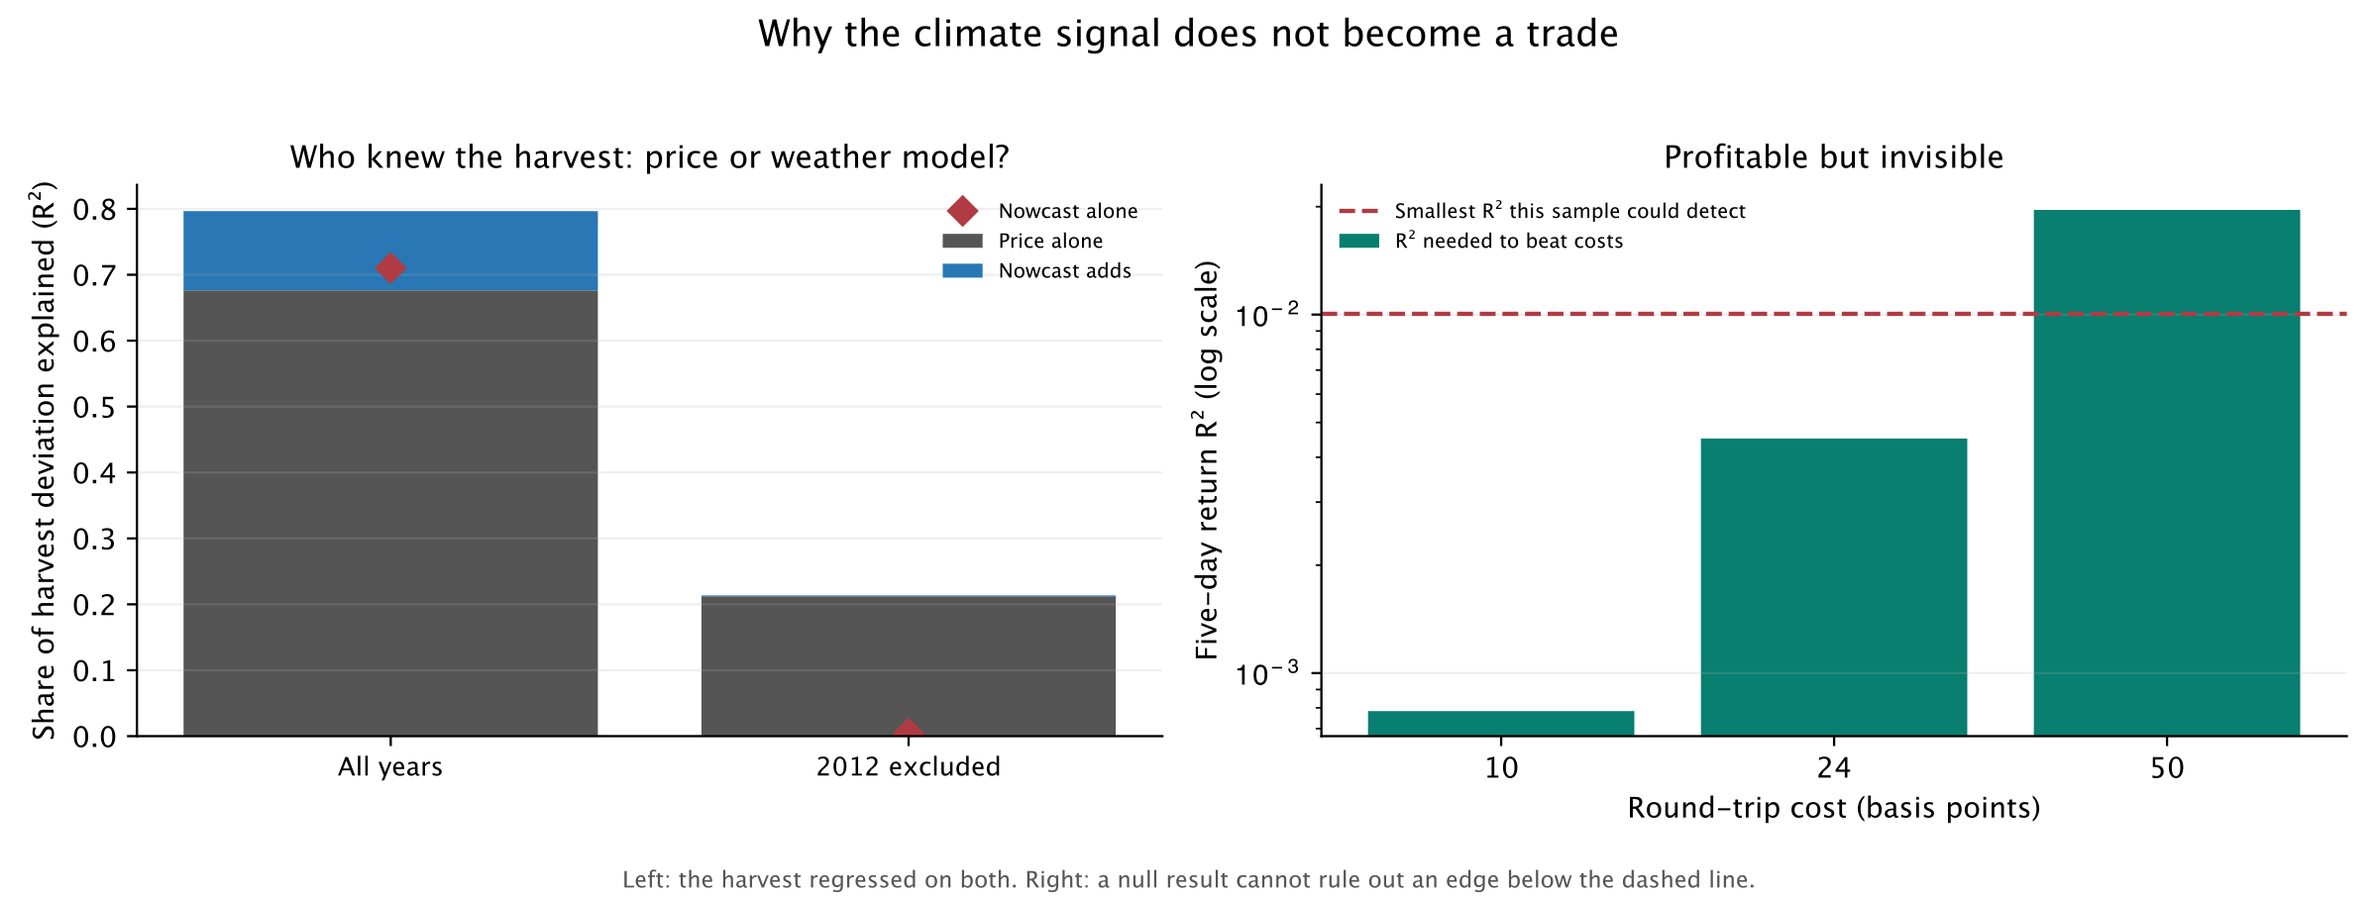



Why it does not become a trade
Three separate reasons for that result — not one excuse for it
ALREADY PRICED
BELOW RESOLUTION
AND IT LOST MONEY
The December contract explains 0.676 of the harvest on its own. The nowcast adds +0.120, and +0.001 without 2012.
Break-even is an R² of 0.00078; 781 independent returns can only detect 0.01005. A factor of 13.
The losses on the previous slide are the strongest sign. An edge too small to detect scatters near zero — it does not lose 52%.
The race is run on the harvest, not on returns: it asks who knew what, rather than whether the signal predicts the price.
Notes:
1:35 · leave by 6:30
• The core slide. Three reasons, not one excuse
• ONE — already priced. Race run on the HARVEST, not returns: who knew what?
• Price 0.676, nowcast 0.710, together only 0.797 — same information
• Nowcast adds +0.120; +0.001 without 2012
• TWO — break-even sits 13× under what 781 returns can detect
• THREE — it lost money, which an invisible edge would not do
IF ASKED — "could a bigger sample find an edge?"
Possibly: ~10,019 independent returns against 781 available. But it cuts
both ways — the losses are far too large to be a small positive edge. The
power argument bounds the evidence; it does not rescue the model.

Slide 8
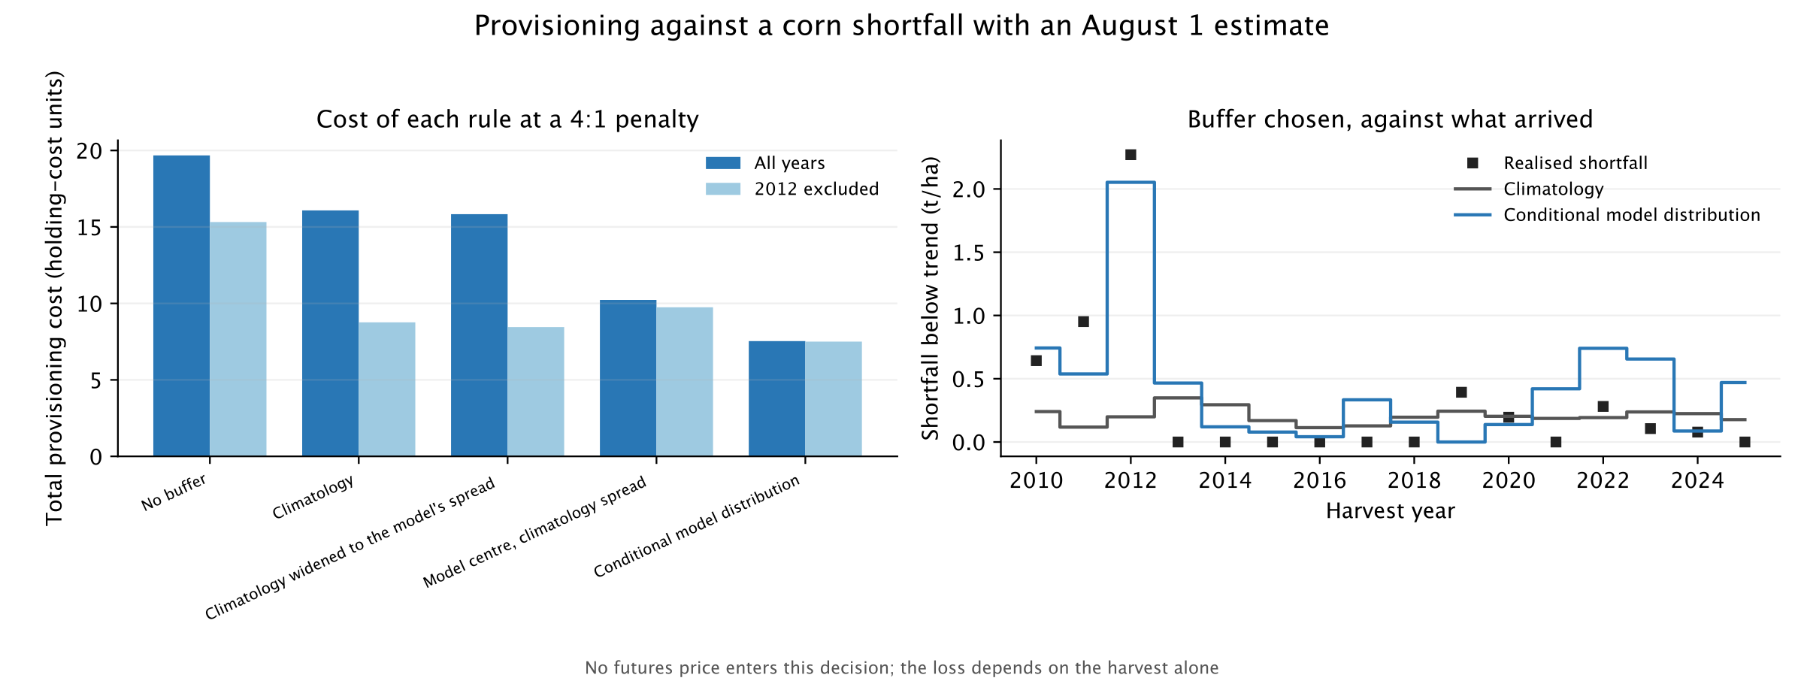
Who can still use it
Not a speculator — someone who already holds the risk, tested without any price
53%
0.76×
14%
provisioning cost saved against a no-weather baseline, at a 4:1 penalty
the model is the narrower distribution — so this is not over-provisioning
without 2012 — but the bootstrap straddles zero (P = 66%)
No futures price enters the decision, so it cannot restate the rejected trading signal as a profit.
Notes:
1:00 · leave by 7:30
• So who uses it? Not a speculator — someone already holding the exposure
• Price-free by construction: no futures position anywhere in the test
• Saves 53% of provisioning cost vs a no-weather baseline
• Control: model is the NARROWER distribution (0.76×) — not just over-provisioning
• Without 2012: 14%, bootstrap straddles zero. Insurance, not a planning tool
IF ASKED — "why no dollar figure?"
A dollar figure needs a price, and a price is how the rejected trading signal
sneaks back in. Costs are in holding-cost units; converting scales every
strategy identically and changes no ranking.

Slide 9


THE ANSWER
Free weather data measures a real
supply shock. The market already
knows about it.
Measurement
Validated forward, concentrated in extreme seasons
Efficiency
Priced in by the time the model can compute it
Use
Insurance for a buyer holding the risk — not an edge
Questions?
github.com/haydn-s/climate-futures-pricing
Notes:
0:30 · leave by 8:00 · then 2:00 for questions
• Measures a real supply shock — in the seasons that matter
• Already priced by the time the model can compute it
• Insurance for someone holding the risk, not an edge
• Reproducible: locked protocols, committed outputs, sealed holdouts that stayed sealed
Q&A INDEX — the five anticipated questions and the slide holding each answer:
USDA as benchmark .............. measurement
2012 as an outlier ............. concentration
sample too small to calibrate .. uncertainty
bigger sample, real edge? ...... efficiency
why no dollar figure ........... provisioning
If asked something not here: say what would settle it and what the repository
would need, rather than speculating. That is the project's whole method.

